Slide 1
Session 3 random distributionS

Slide 2
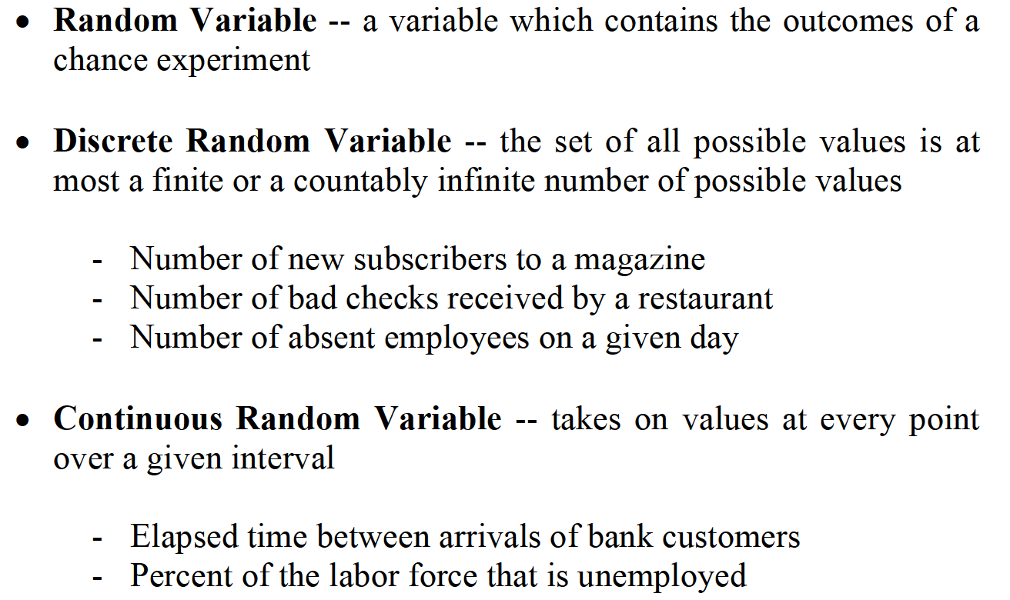
DISCRETE VS. CONTINUOUS DISTRIBUTIONS

Slide 3
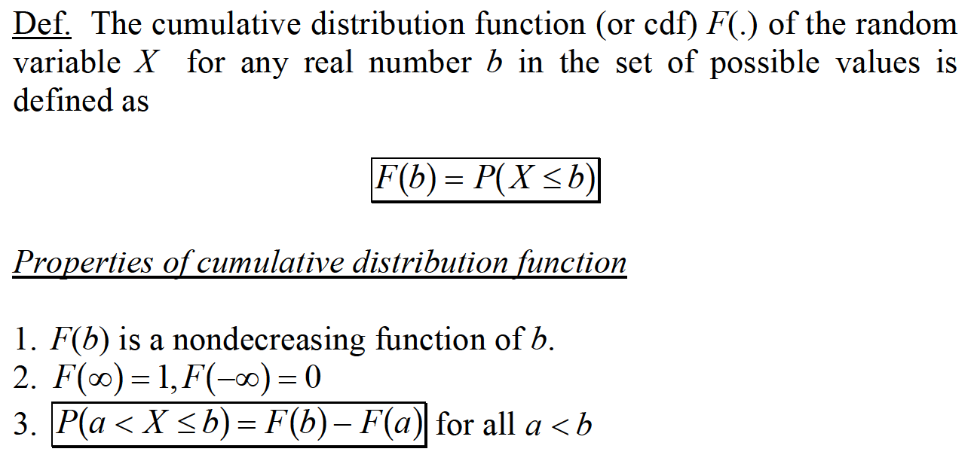
CUMULATIVE DISTRIBUTION FUNCTION

Slide 4
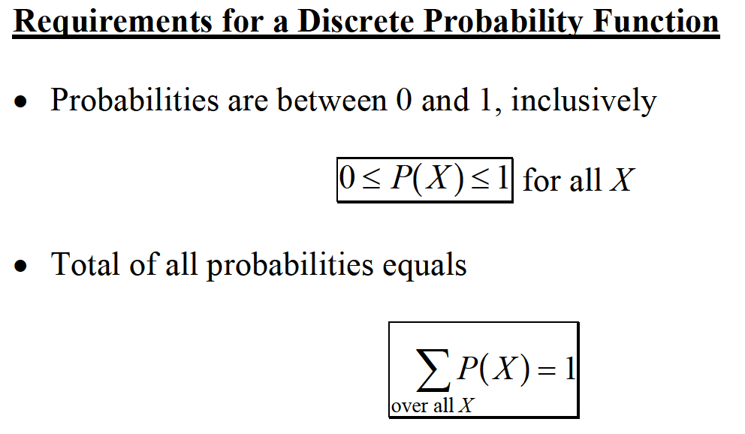
DISCRETE RANDOM VARIABLES

Slide 5

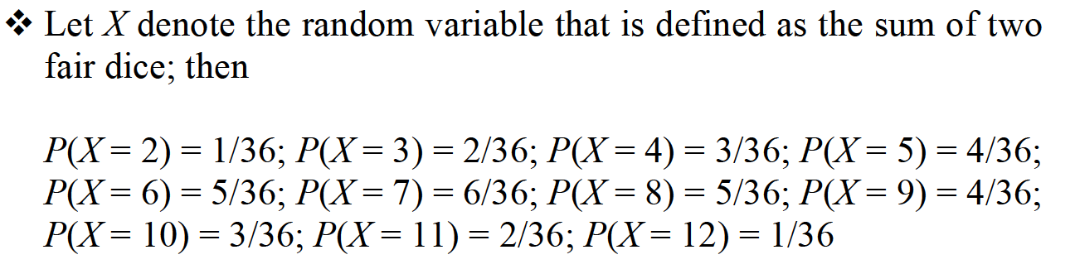
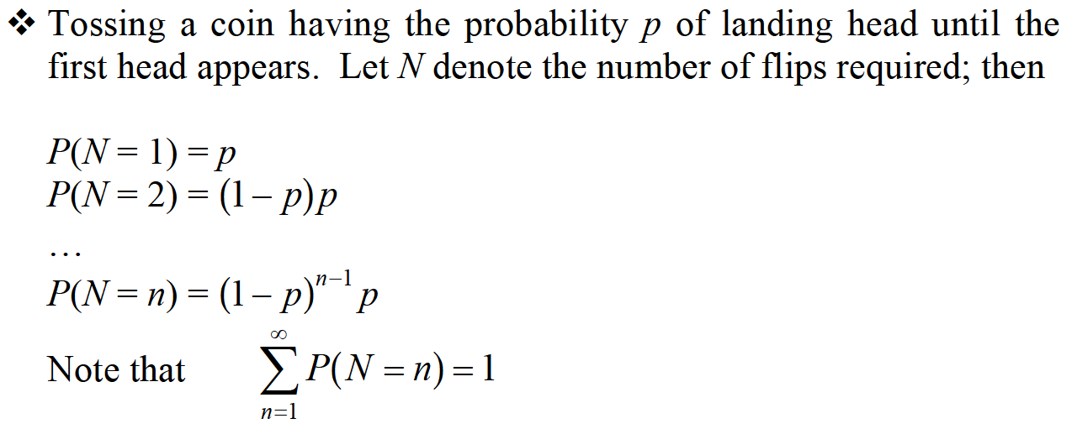
DISCRETE RANDOM VARIABLES

Slide 6

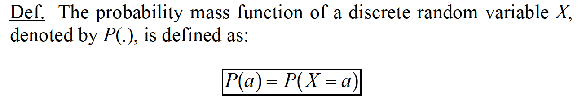
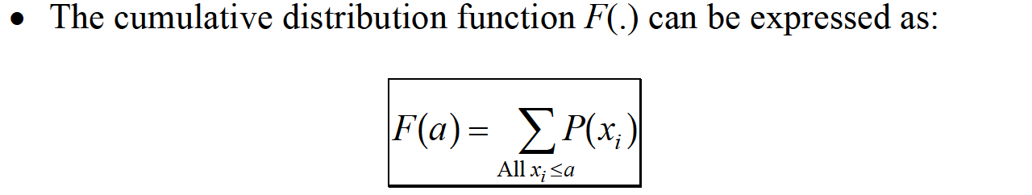

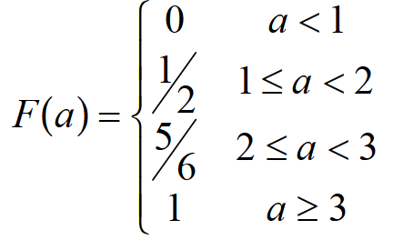
DISCRETE RANDOM VARIABLES

Slide 7
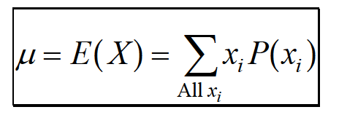
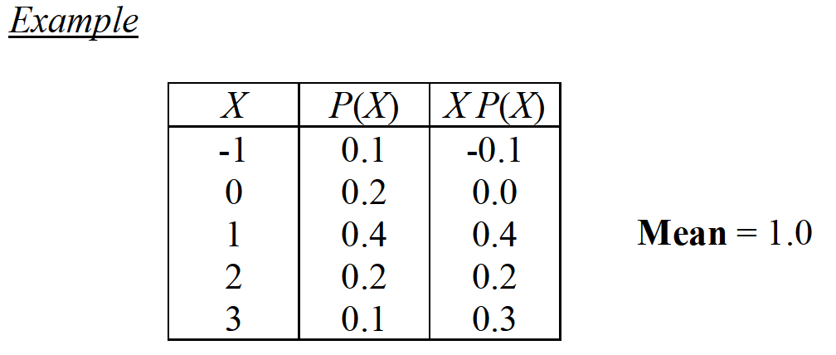
DISCRETE RANDOM VARIABLES

Slide 8
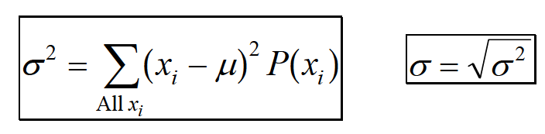
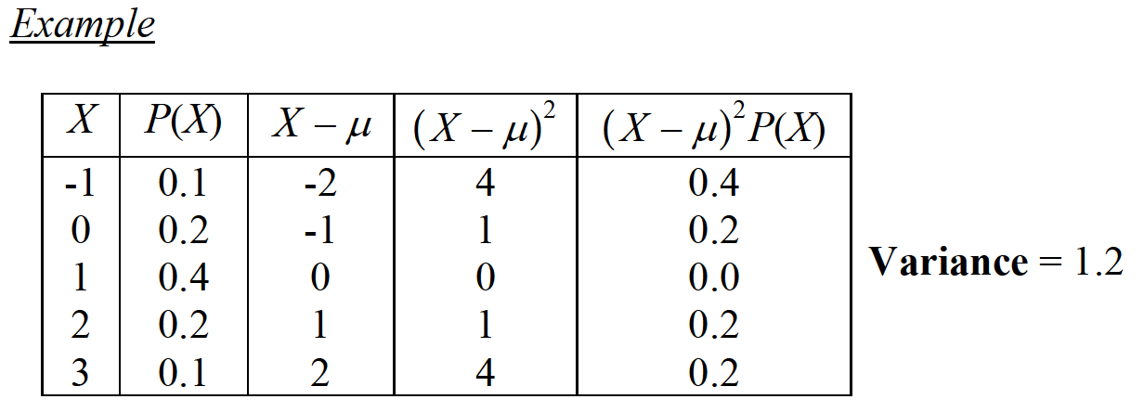
DISCRETE RANDOM VARIABLES

Slide 9

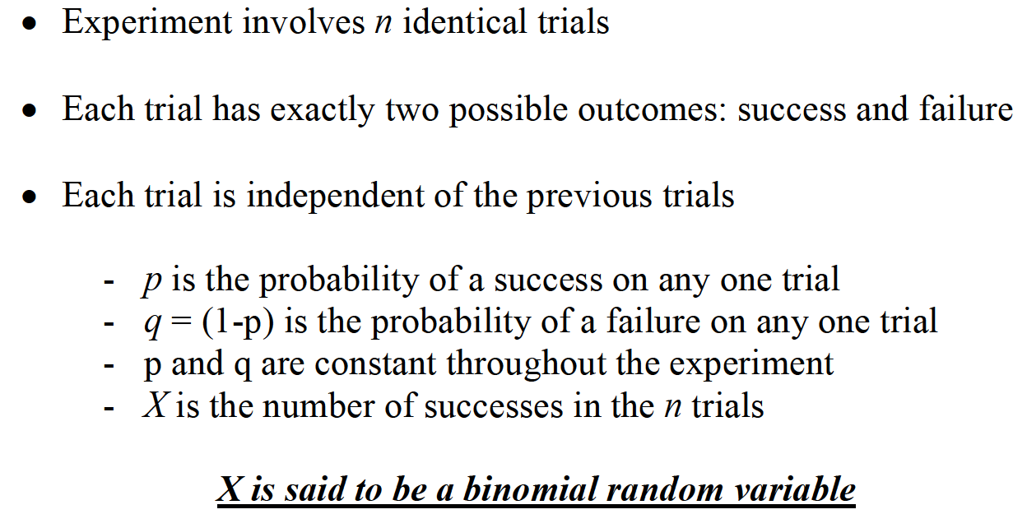
DISCRETE RANDOM VARIABLES

Slide 10
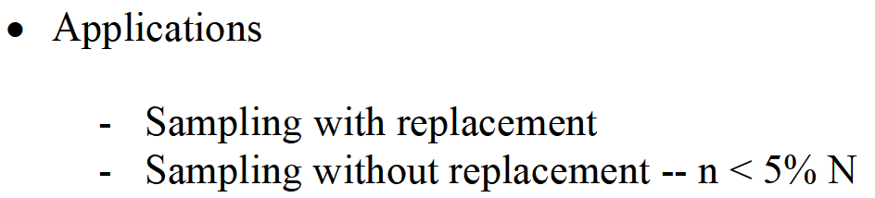
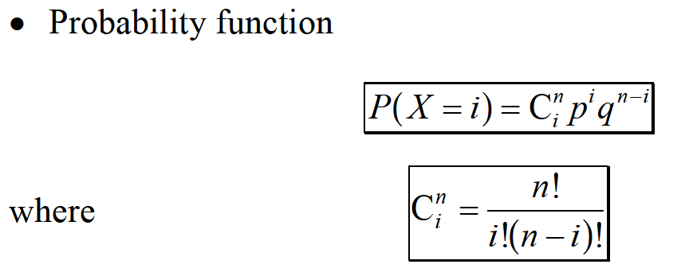
DISCRETE RANDOM VARIABLES

Slide 11
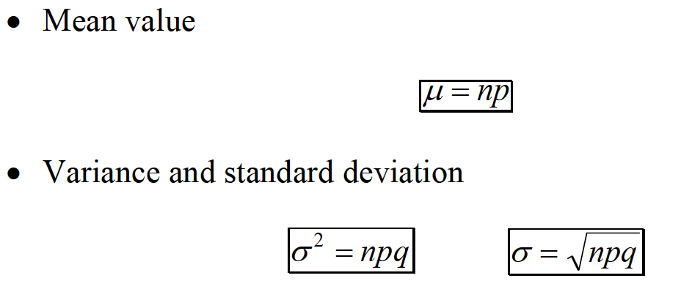
DISCRETE RANDOM VARIABLES

Slide 12

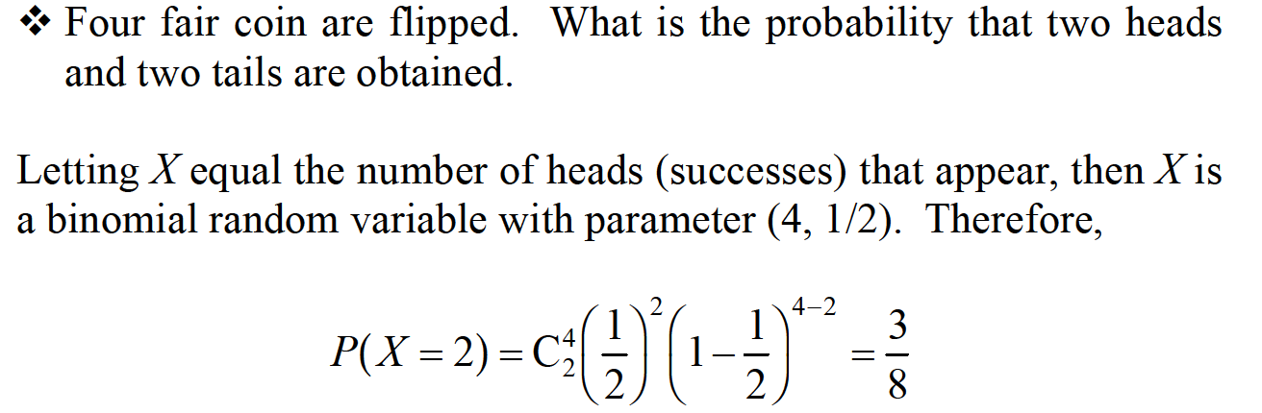
DISCRETE RANDOM VARIABLES

Slide 13
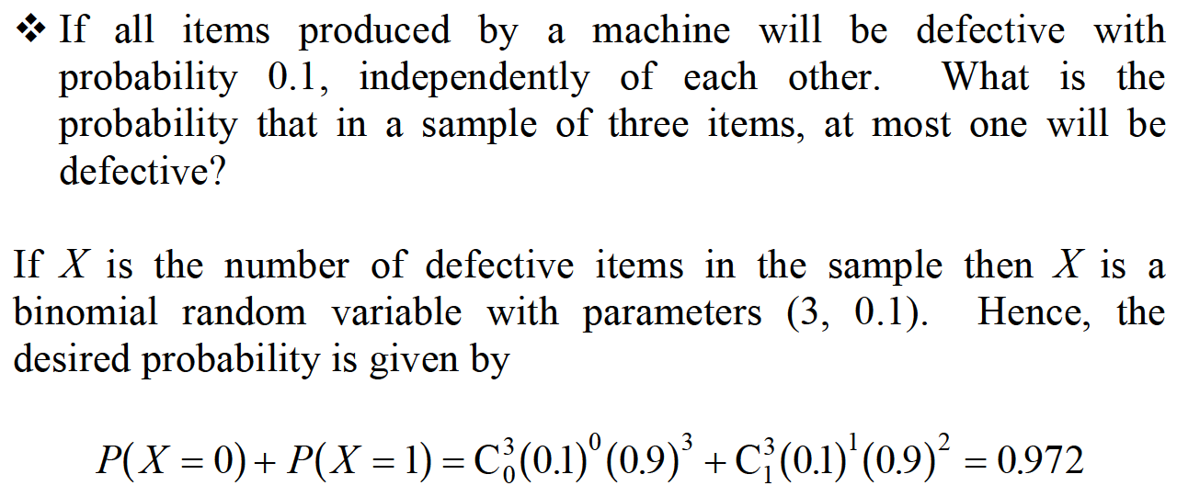
DISCRETE RANDOM VARIABLES

Slide 14

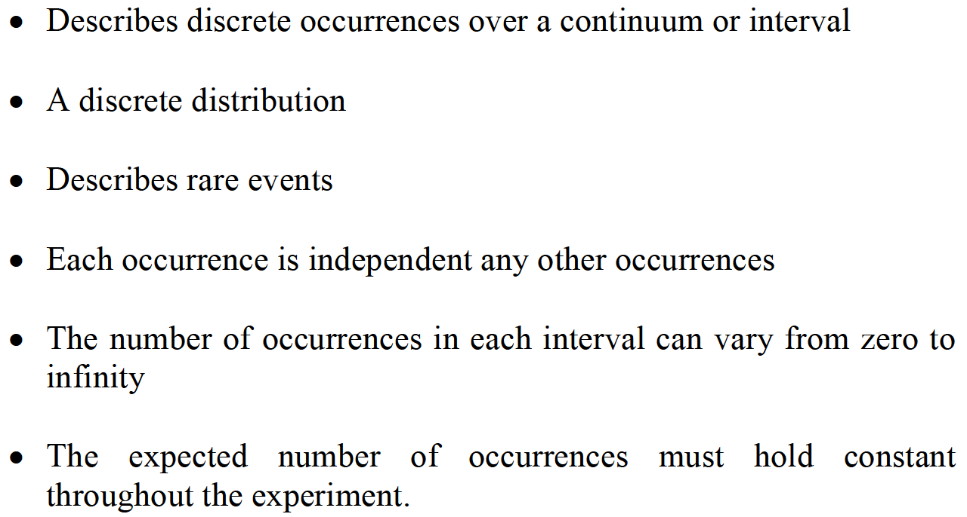
DISCRETE RANDOM VARIABLES

Slide 15
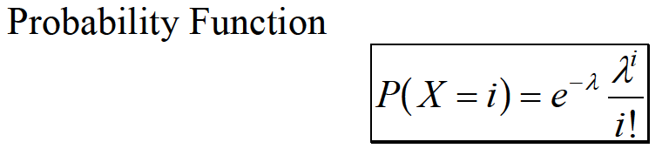
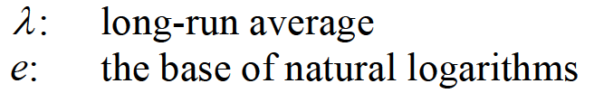


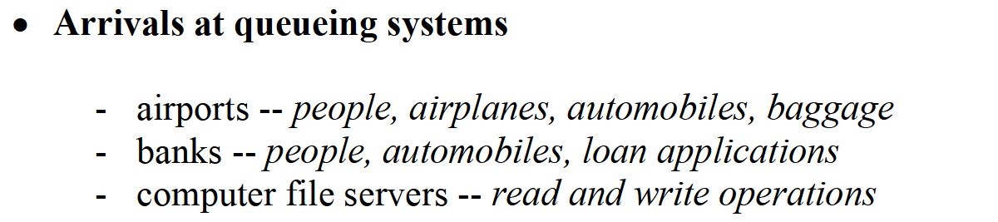
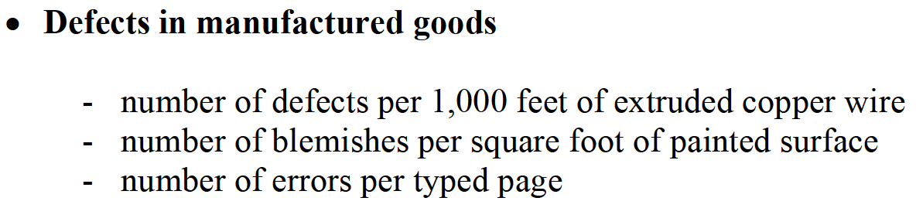
DISCRETE RANDOM VARIABLES

Slide 16
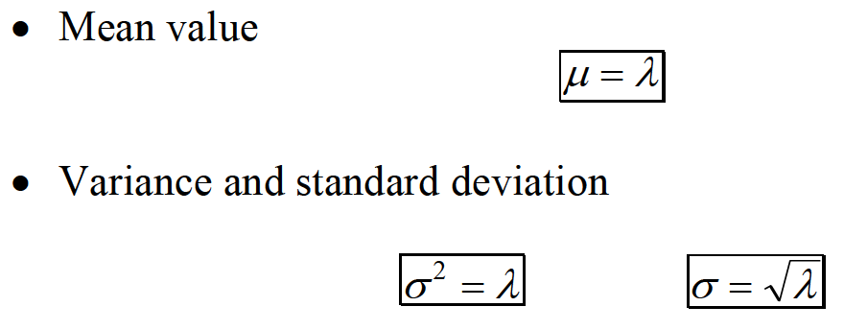
DISCRETE RANDOM VARIABLES

Slide 17

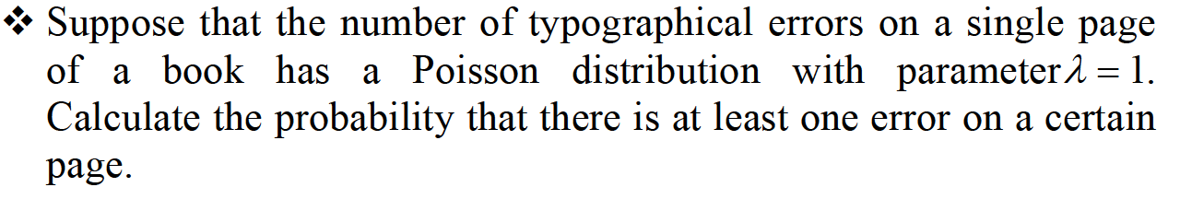
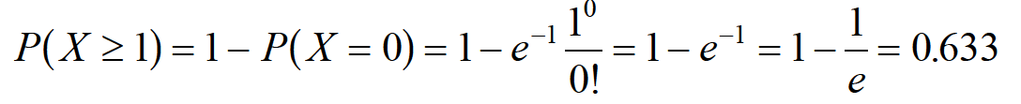
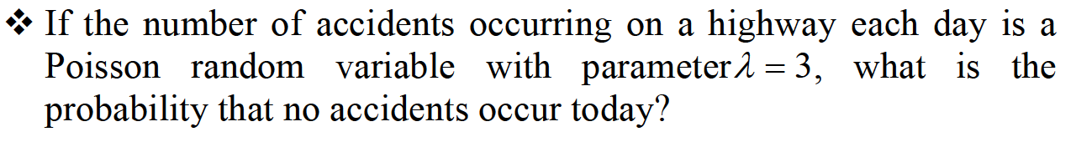
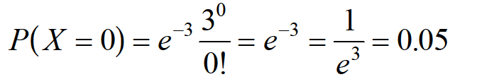
DISCRETE RANDOM VARIABLES

Slide 18
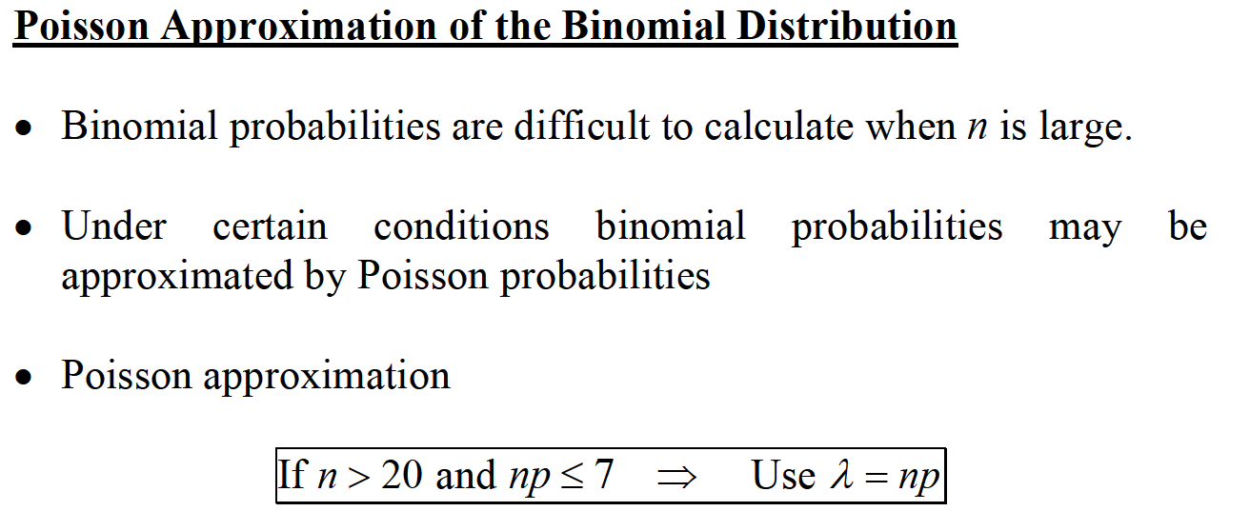
DISCRETE RANDOM VARIABLES

Slide 19

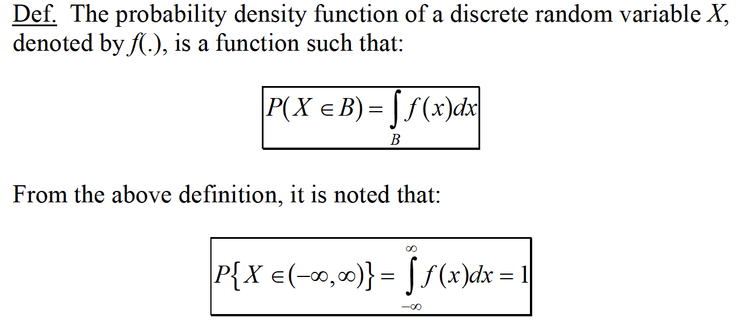
CONTINUOUS RANDOM VARIABLES

Slide 20

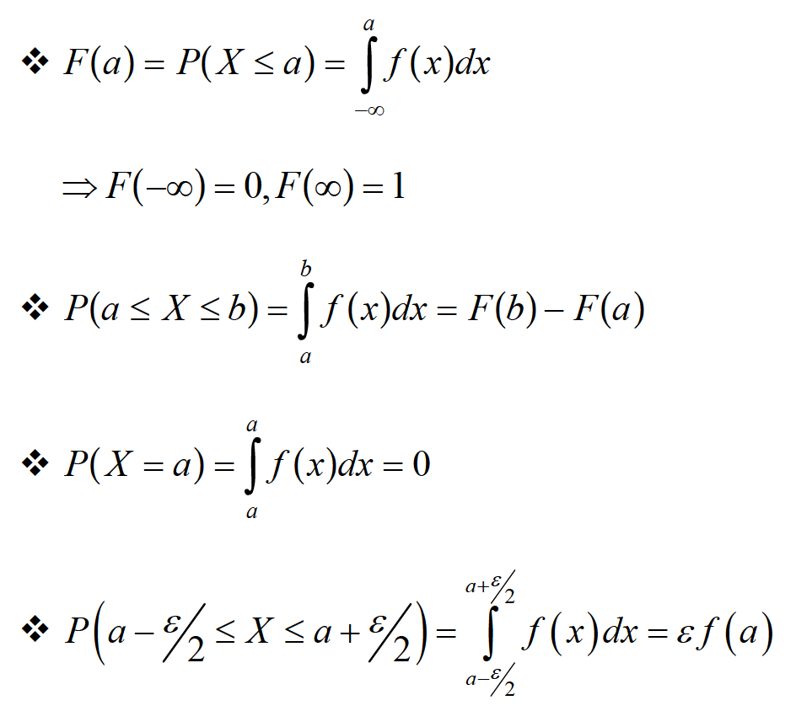
CONTINUOUS RANDOM VARIABLES

Slide 21

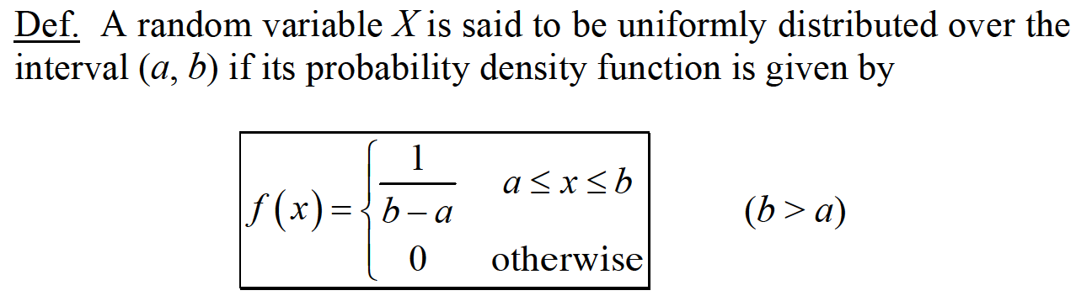
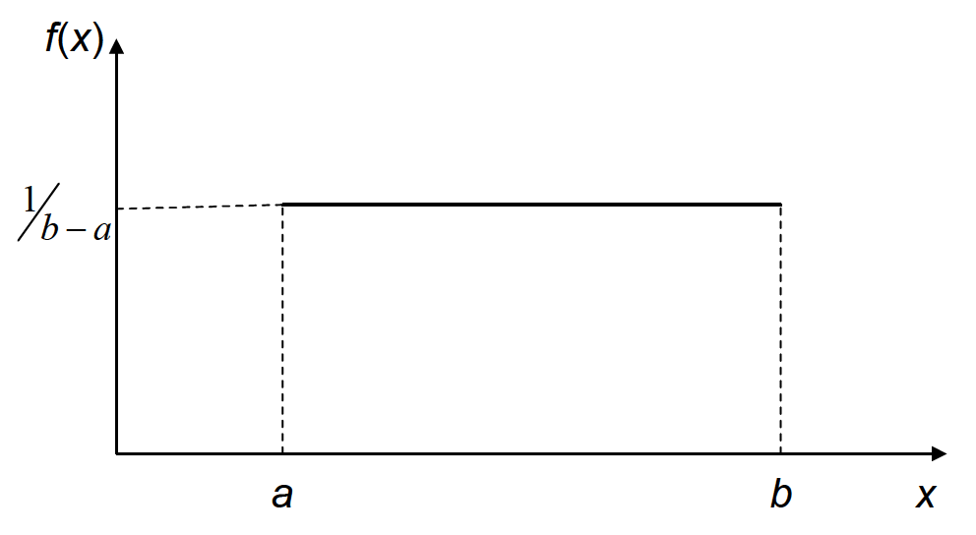
CONTINUOUS RANDOM VARIABLES

Slide 22
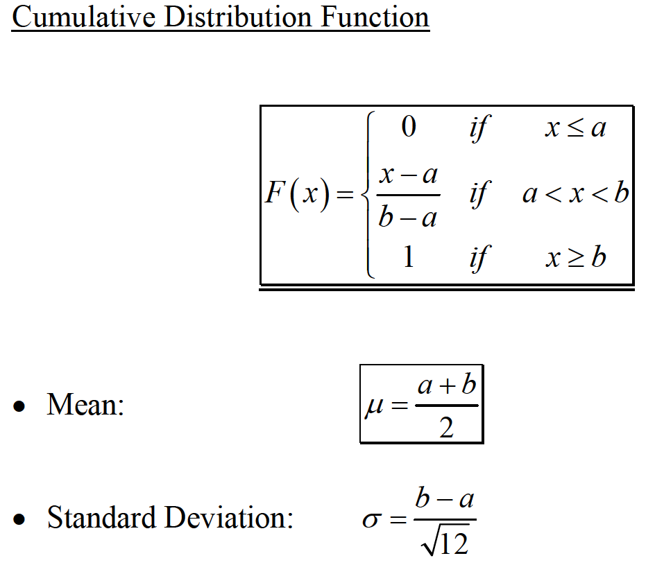
CONTINUOUS RANDOM VARIABLES

Slide 23

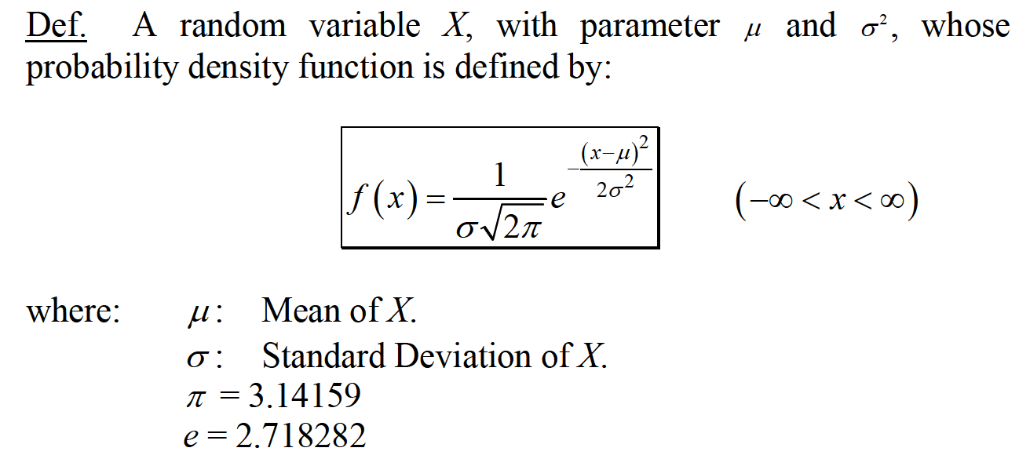
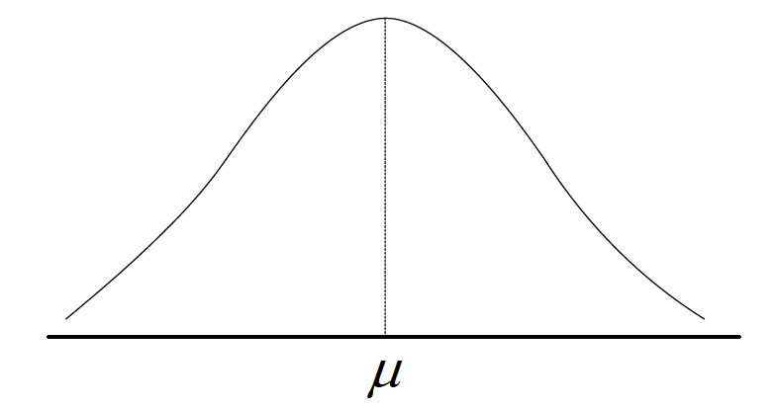
CONTINUOUS RANDOM VARIABLES

Slide 24
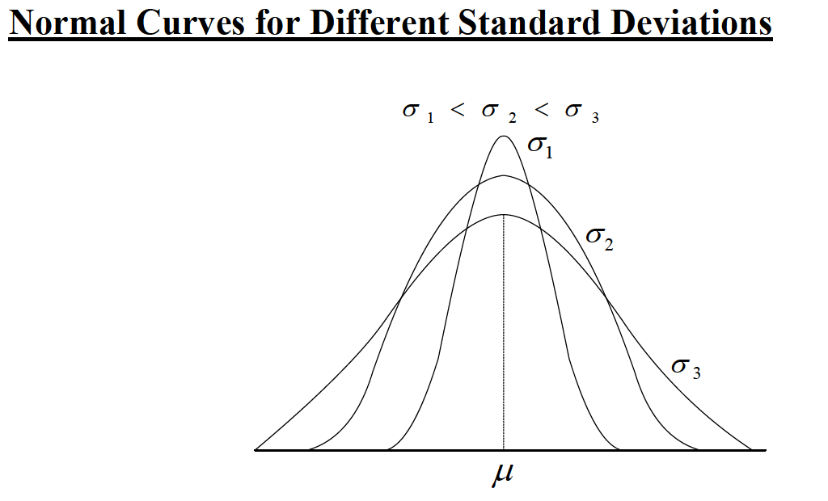
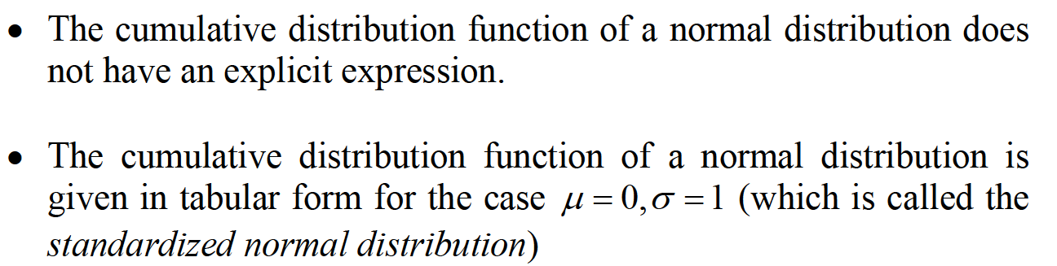
CONTINUOUS RANDOM VARIABLES

Slide 25


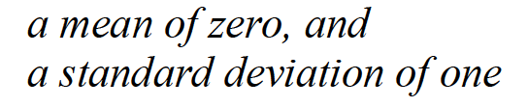


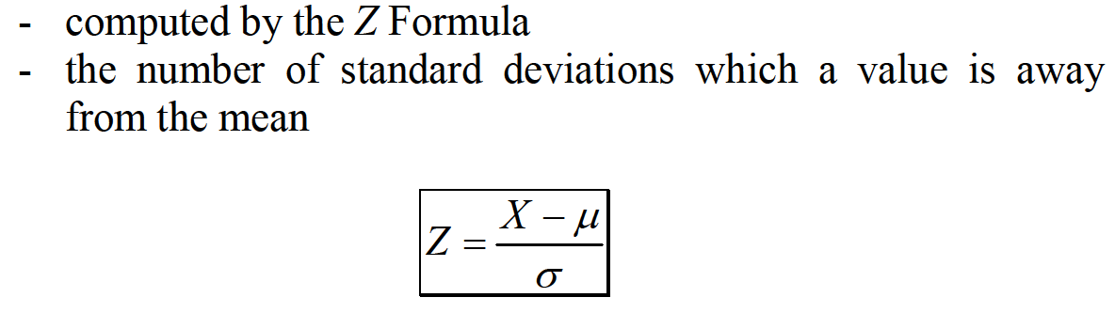
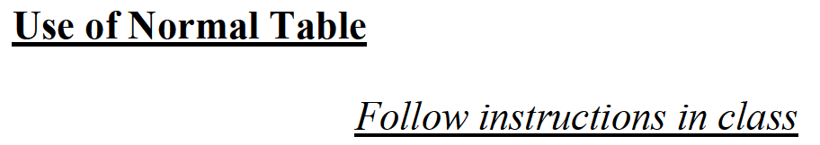
CONTINUOUS RANDOM VARIABLES

Slide 26
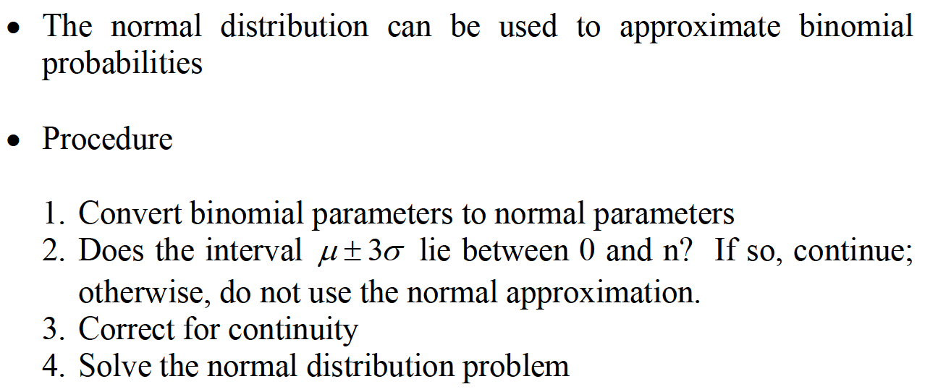
CONTINUOUS RANDOM VARIABLES

Slide 27
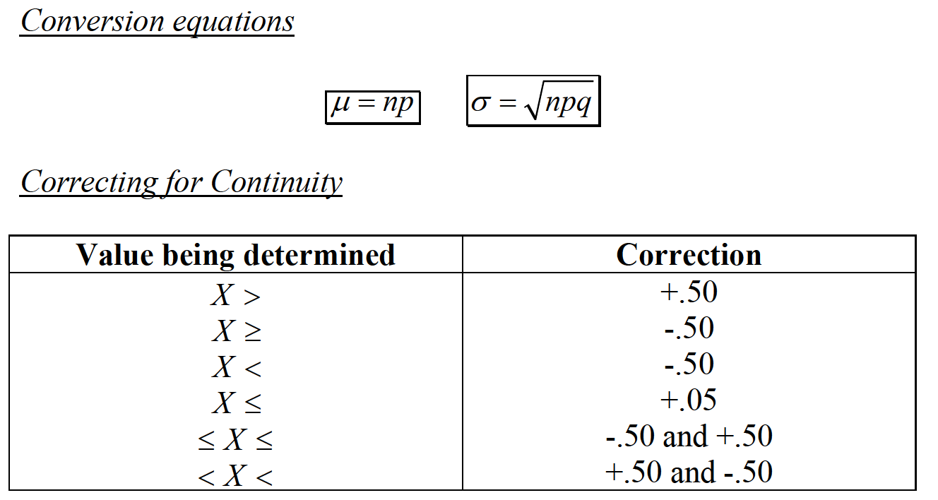
CONTINUOUS RANDOM VARIABLES

Slide 28
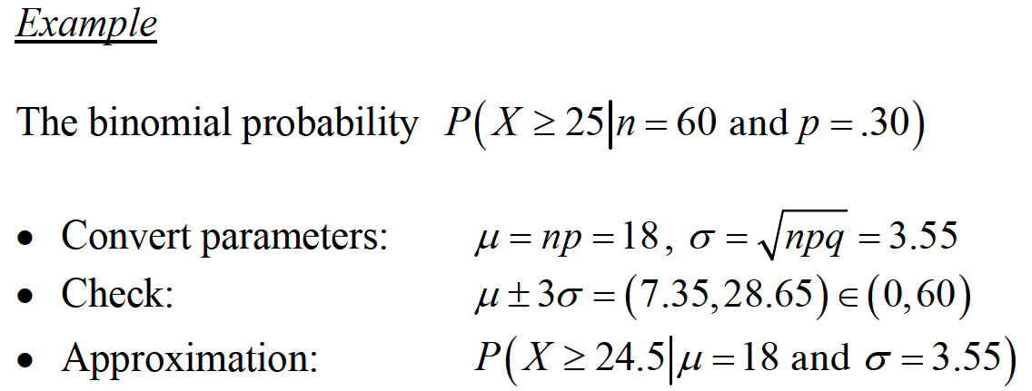
CONTINUOUS RANDOM VARIABLES

Slide 29

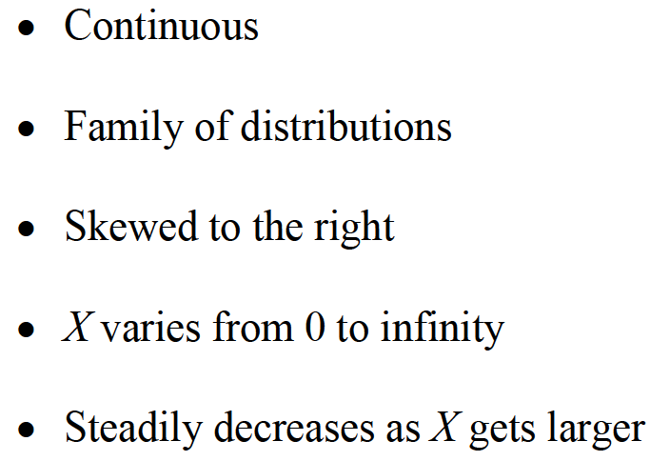
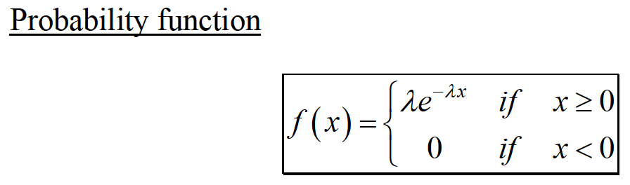
CONTINUOUS RANDOM VARIABLES

Slide 30
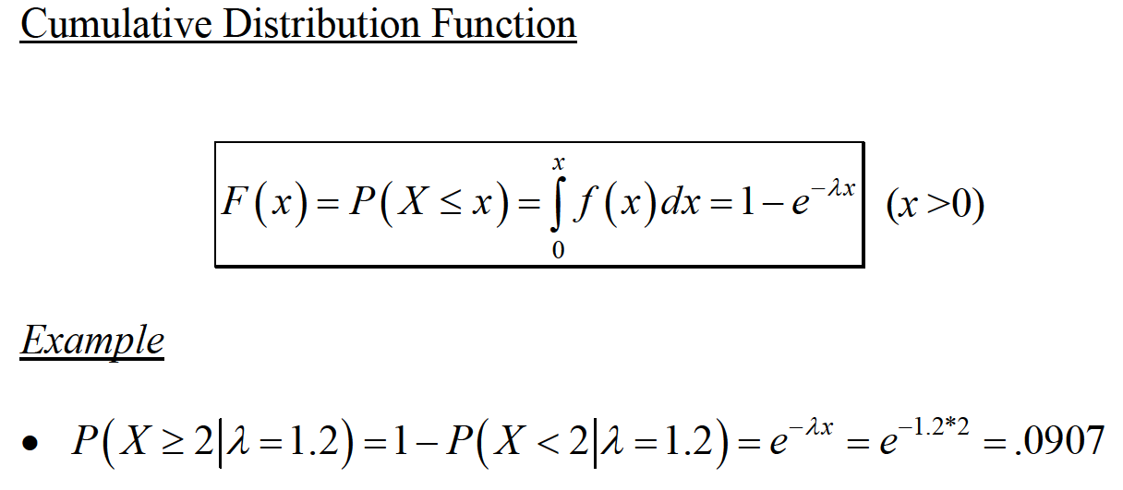
CONTINUOUS RANDOM VARIABLES

Slide 31

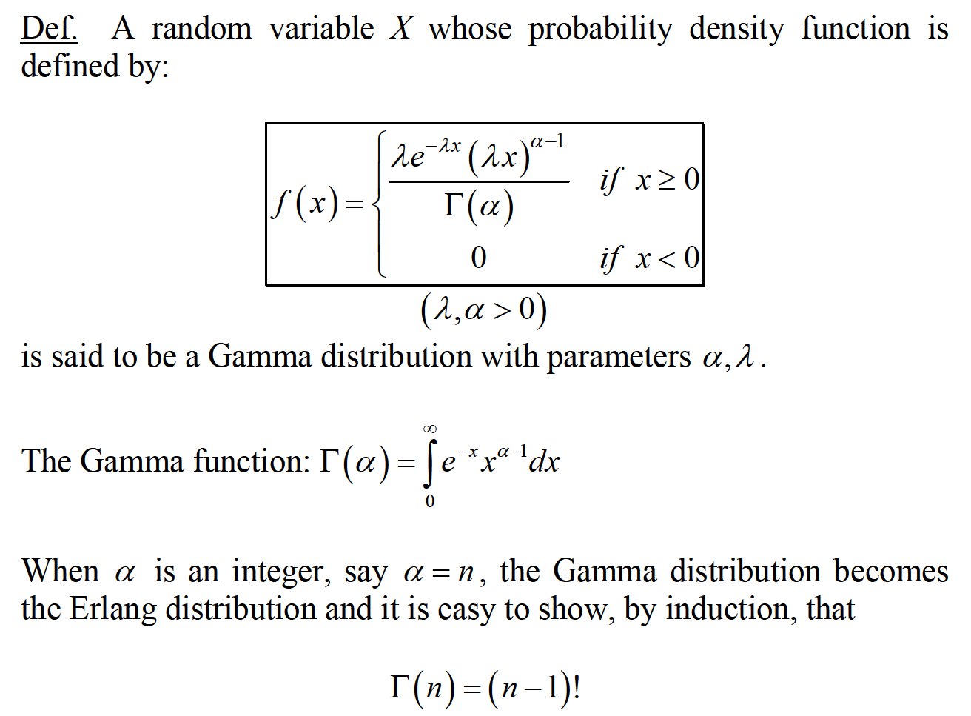
CONTINUOUS RANDOM VARIABLES

Slide 32

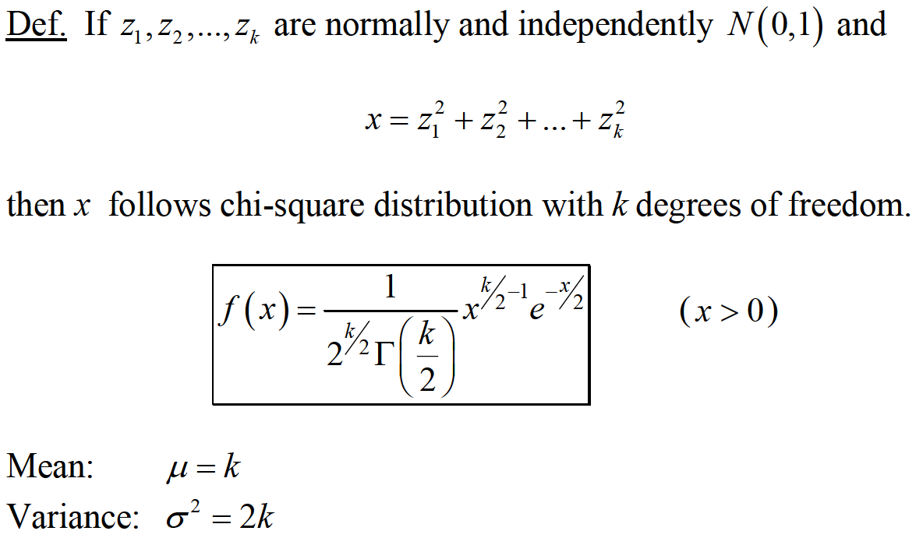
CONTINUOUS RANDOM VARIABLES

Slide 33
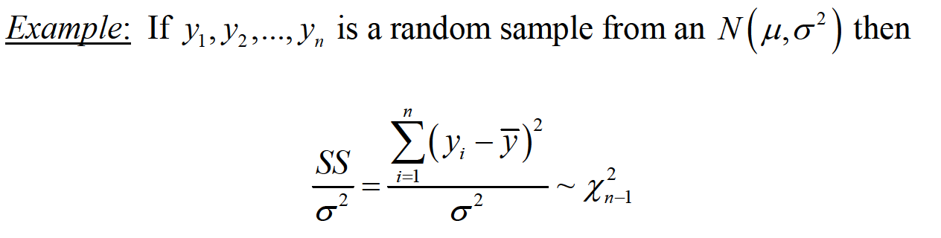
CONTINUOUS RANDOM VARIABLES

Slide 34




CONTINUOUS RANDOM VARIABLES

Slide 35


CONTINUOUS RANDOM VARIABLES

Slide 36

CONTINUOUS RANDOM VARIABLES

Slide 37

FUNCTION OF RANDOM VARIABLES

Slide 38

FUNCTION OF RANDOM VARIABLES

Slide 39


PROPERTIES OF EXPECTATION & VARIANCE

Slide 40

MARKOV’S INEQUALTY

Slide 41

CHEBYSHEV’S INEQUALTY

Slide 42


EXAMPLE

Slide 43

THE STRONG LAW OF LARGE NUMBER

Slide 44

CENTRAL LIMIT THEOREM

